Slide 1


Finance, and supply chain analytics For Atliq Hardware
Sql Project By Akhil

Slide 2
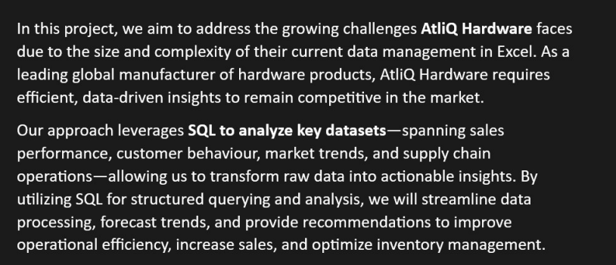
PROJECT OVERVIEW
OPTIMIZING ATLIQ HARDWARE’S OPERATIONS
THROUGH SQL

Slide 3
table OF CONENTS
ABOUT ATLIQ
BUSINESS MODEL
PROBLEM STATEMENT
REPORTS
CONCLUSION

Slide 4


Atliq hardware AND BUSINESS MODEL

Slide 5
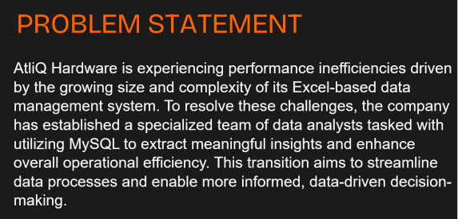
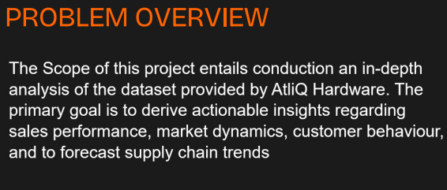
Problem statement and problem overview

Slide 6
Data set
DIMENSION TABLES
DIM_CUSTOMER
DIM_DATE
DIM_PRODUCT
FACT TABLES
FACT_FORCAST_MONTHLY
FACT_FREIGHT_COST
FACT_GROSS_PRICE
FACT_MANUFACTURING_COST
FACT_POST_INVOICE_DEDUCTION
FACT_PRE_INVOICE_DEDUCTION
FACT_SALES_MONTHLY

Slide 7
Part 1: Finance analYtics
CROMA INDIA PRODUCT WISE SALES REPORT FOR FISCAL YEAR 2021
WE HAVE TO GENERATE A REPORT OF INDIVIDUAL PRODUCT SALES(AGGREGATED ON MONTHLY BASIS AT THE PRODUCT CODE LEVEL) FOR CROMA INDIA CUSTOMER FOR FY=2021 SO THAT WE CAN TRACK PRODUCT SALES AND RUN FURTHUR PRODUCT ANALYTICS
REPORT SHOULD HAVE THE FOLLOWING FIELDS:
Month
Product Name
Variant
Sold Quantity
Gross Price Per Item
Gross Price Total

Slide 8
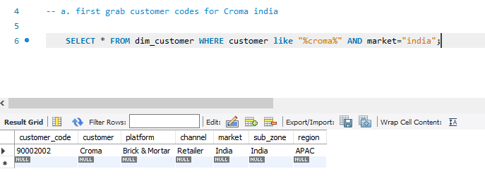
Module: User-Defined SQL Function
a. first grab customer codes for Croma india

Slide 9
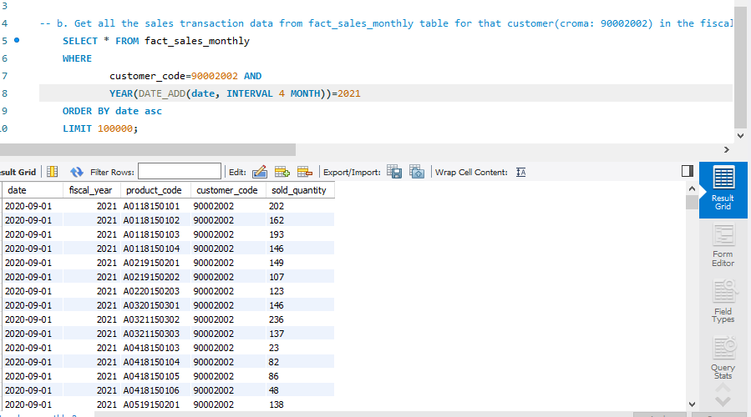
b. Get all the sales transaction data from fact_sales_monthly table for that customer(croma: 90002002) in the fiscal_year 2021

Slide 10
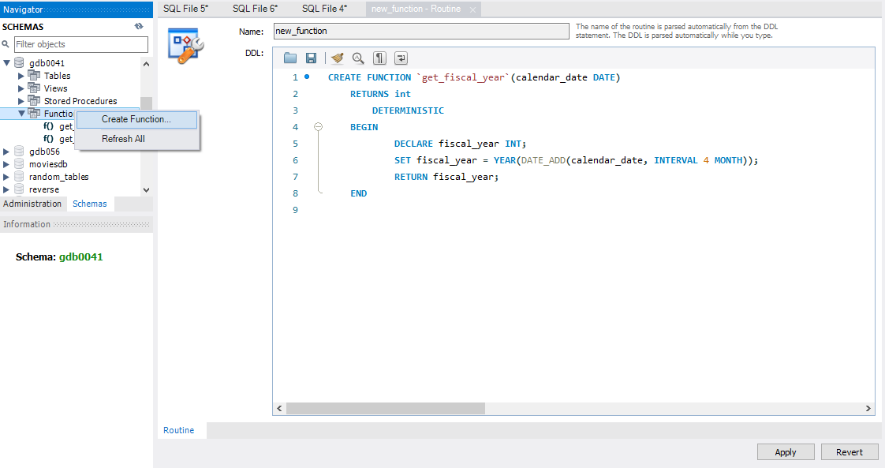
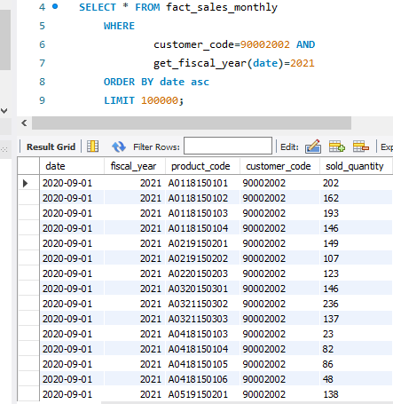
c. create a function 'get_fiscal_year' to get fiscal year by passing the date
d. Replacing the function created in the step:b

Slide 11
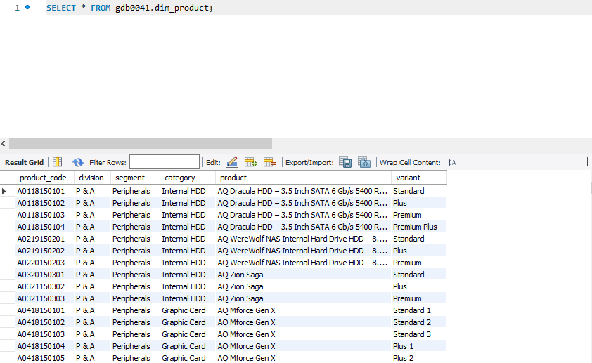
Module: Gross Sales Report: Monthly Product Transactions
Till now we have find 1.Month and 4.sold quantity column now we have to find 2.Product Name and 3.Variant to find these column we need to go for dim_product table because these column present in product table

Slide 12
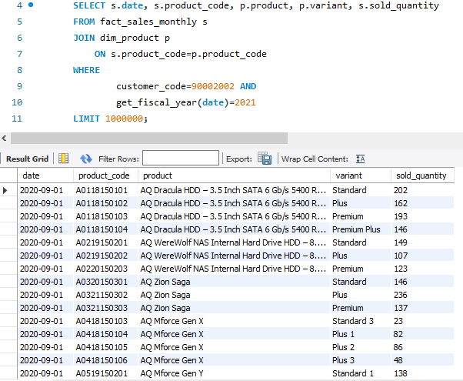
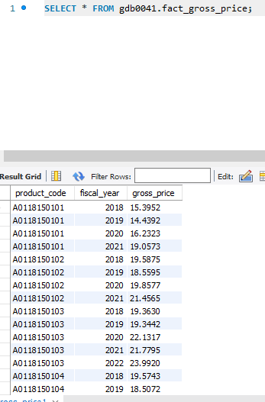
a. Perform joins to pull product information
Till now we have four column :
Month
Product Name
Variant
Sold quantity
We require two more column:
5. Gross price per item
6. Gross price total

Slide 13
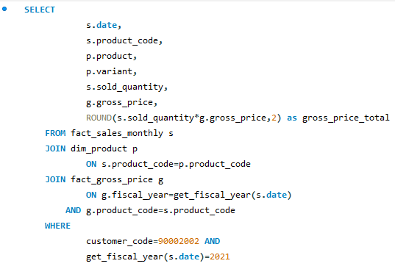
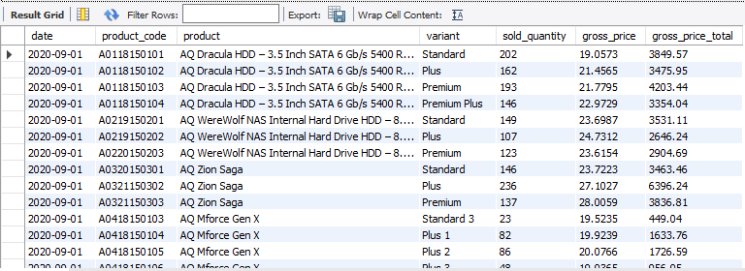
b. Performing join with 'fact_gross_price' table with the above query and generating required fields
Query:
Output:

Slide 14
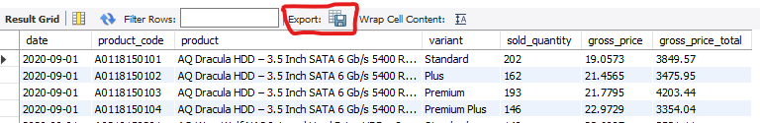
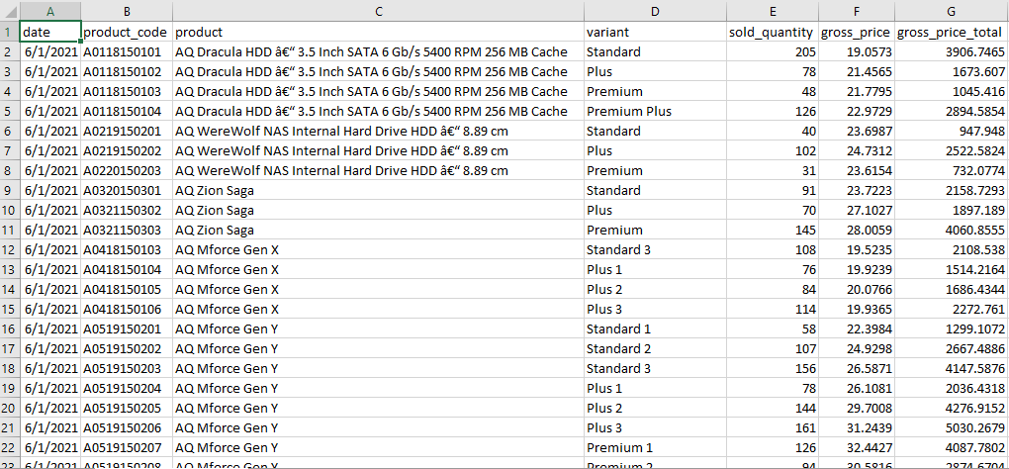
Then we will export this report by click on export button and will save it as csv file which we can open in
Excel and can give it to business manager and product owner.
After export we will convert above report into .csv file and we will open in excel which will look like below

Slide 15
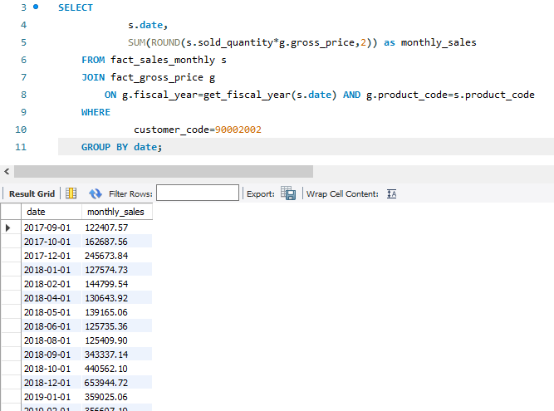
Module: Gross Sales Report: Total Sales Amount
Generate monthly gross sales report for Croma India for all the years

Slide 16
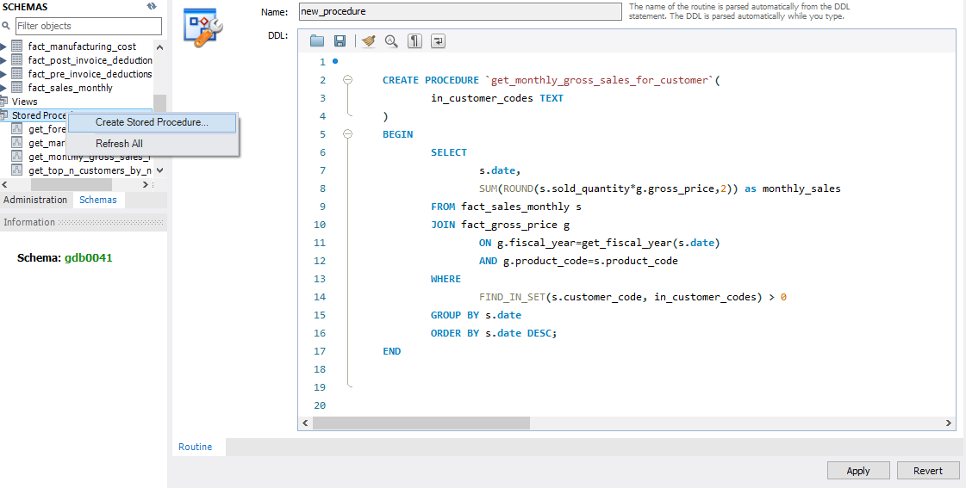
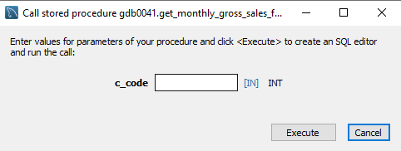
Module: Stored Procedures: Monthly Gross Sales Report
Generate monthly gross sales report for any customer using stored procedure
After click on execution icon of
Stored procedure monthly
Gross sales we will find a new
Screen where we can enter
Customer code and can

Slide 17
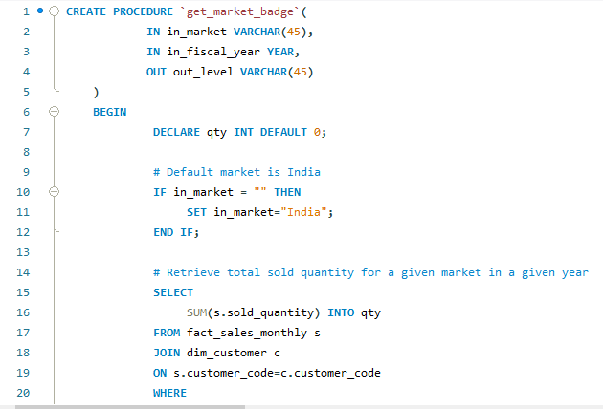
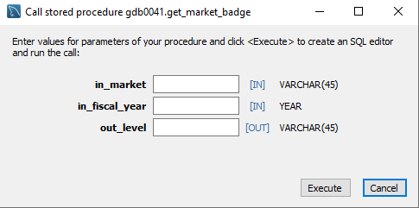
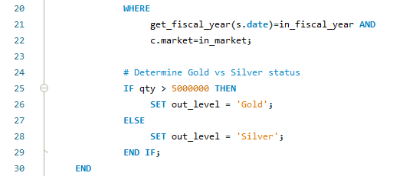
Module: Stored Procedure: Market Badge
Write a stored proc that can retrieve market badge. i.e. if total sold quantity > 5 million that market is considered "Gold" else "Silver"

Slide 18
Benefits of stored procedure
Convenience
Security
Maintainability
Performance
Developer Productivity

Slide 19
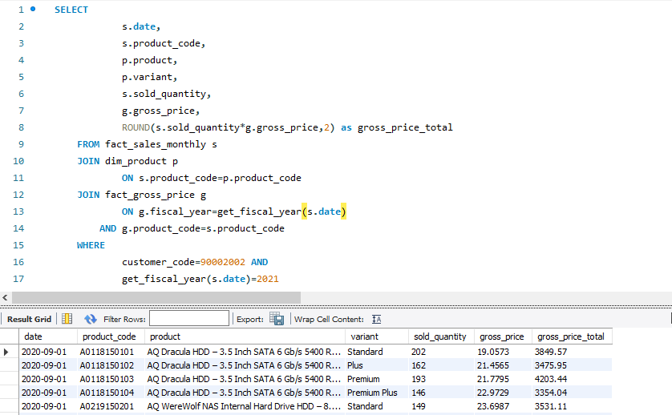
Part -2 : Top Customers, Products, Markets
Module: Problem Statement and Pre-Invoice Discount Report
Till now we have found gross price and gross price total and we have to find top Customers, Products,
Markets so we need to get pre invoice discount coloumn in last query where we get gross price and gross
Discount

Slide 20
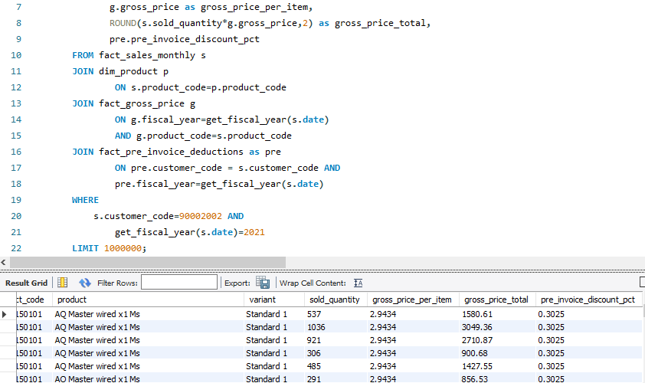
Include pre-invoice deductions in Croma detailed report

Slide 21
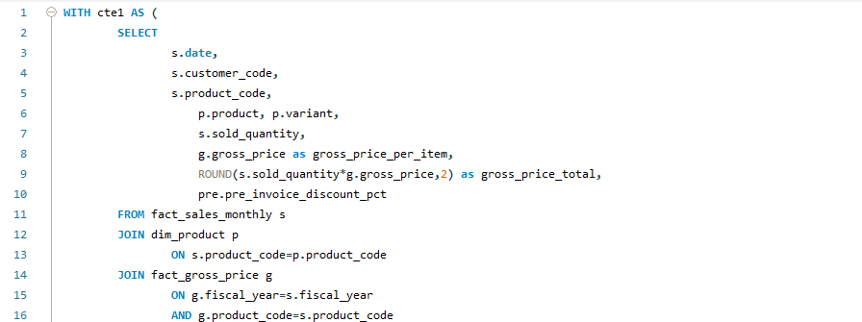
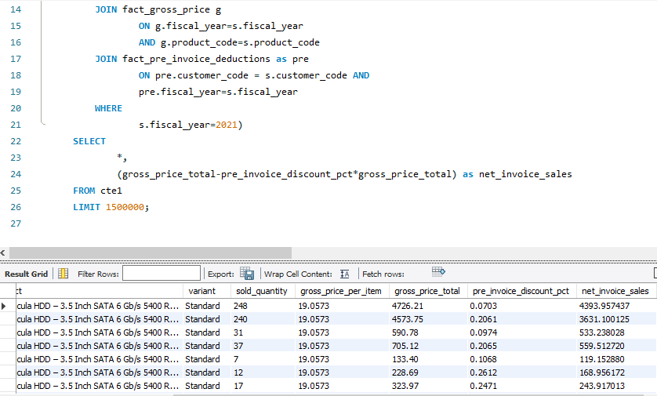
Module: Database Views: Introduction
Get the net_invoice_sales amount using the CTE's

Slide 22
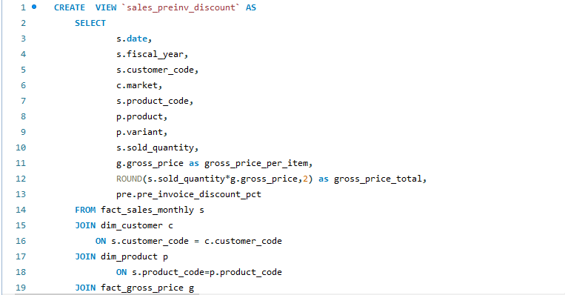
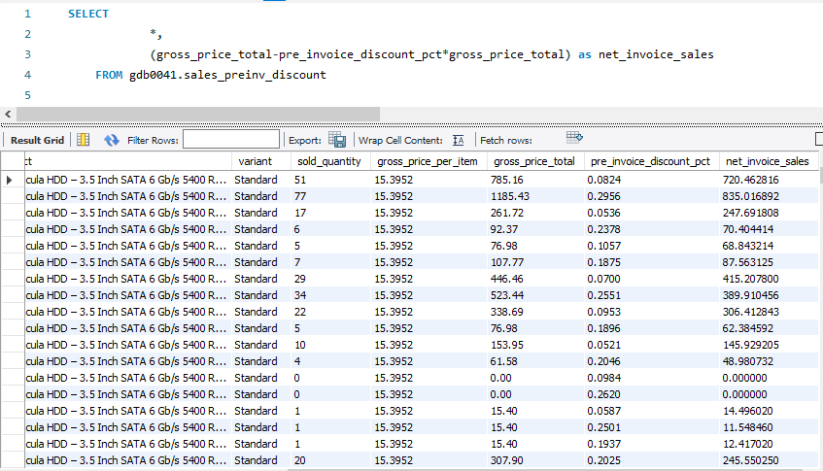
Creating the view `sales_preinv_discount` and store all the data in like a virtual table
Now generate net_invoice_sales using the above created view "sales_preinv_discount"

Slide 23
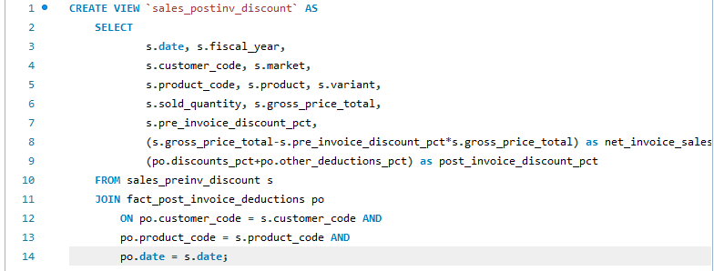
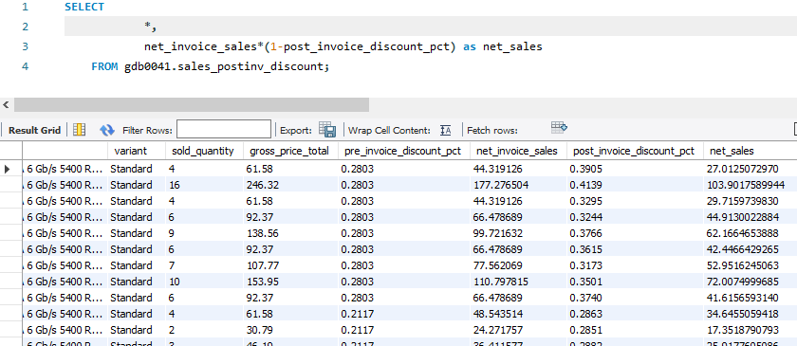
Module: Database Views: Post Invoice Discount, Net Sales
Create a view for post invoice deductions: `sales_postinv_discount`
Create a report for net sales

Slide 24
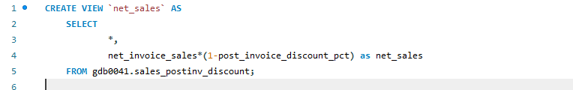
Finally creating the view `net_sales` which inbuiltly use/include all the previous created view and gives the final result

Slide 25
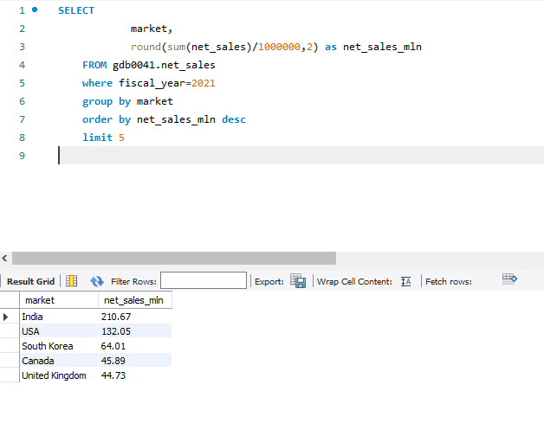
Module: Top Markets and Customers
Get top 5 market by net sales in fiscal year 2021

Slide 26
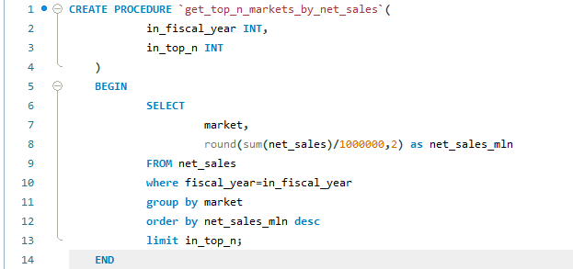
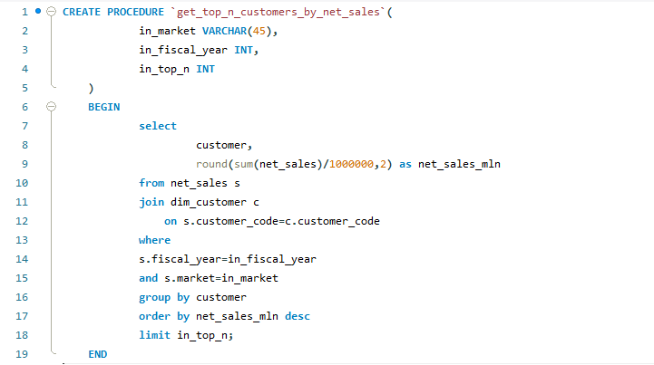
Stored proc to get top n markets by net sales for a given year
stored procedure that takes market, fiscal_year and top n as an input and returns top n customers by net sales in that given fiscal year and market

Slide 27
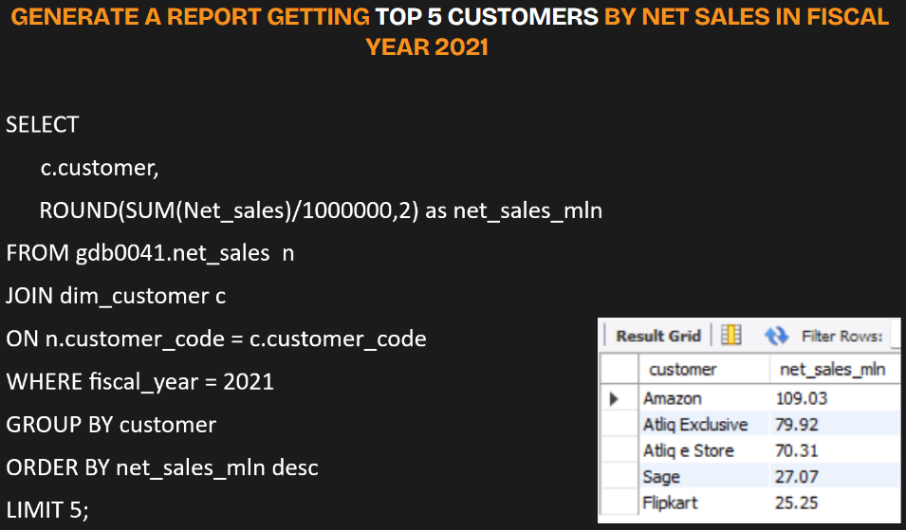

Slide 28
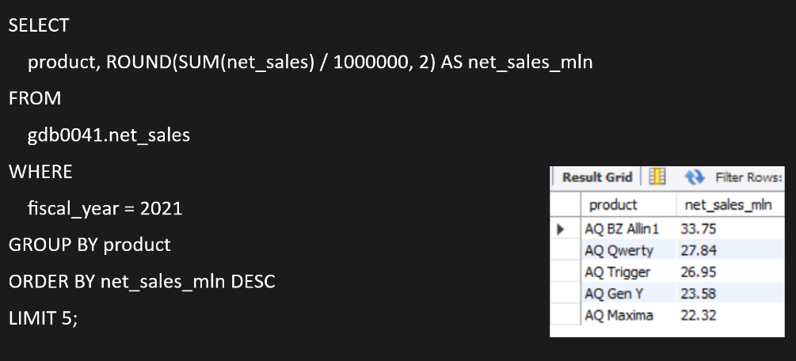
Generate a report getting top 5 products by net sales in fiscal year 2021

Slide 29
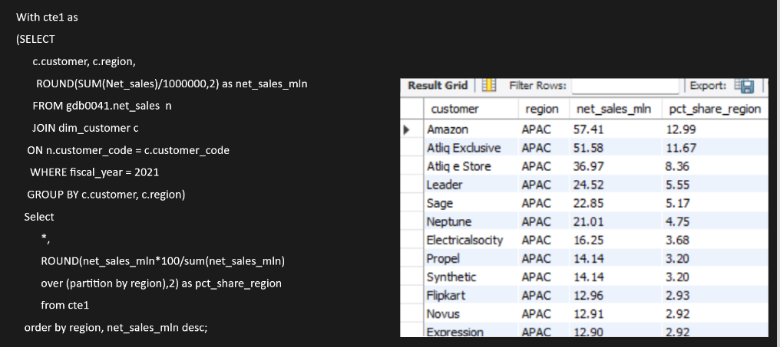
GENERATE A NET SALES % REPORT OF CUSTOMERS IN DIFFERENT REGIONS

Slide 30
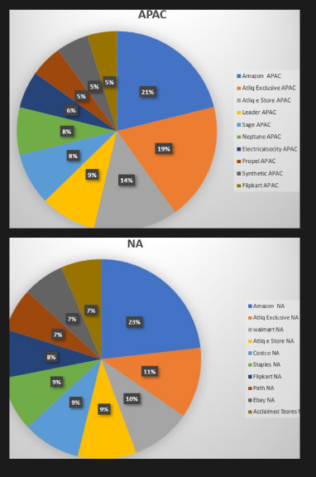
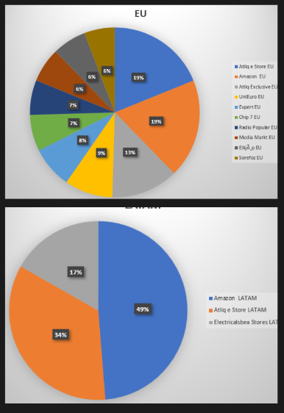
MARKET SHARE % - TOP CUSTOMERS IN DIFFERENT REGIONS

Slide 31
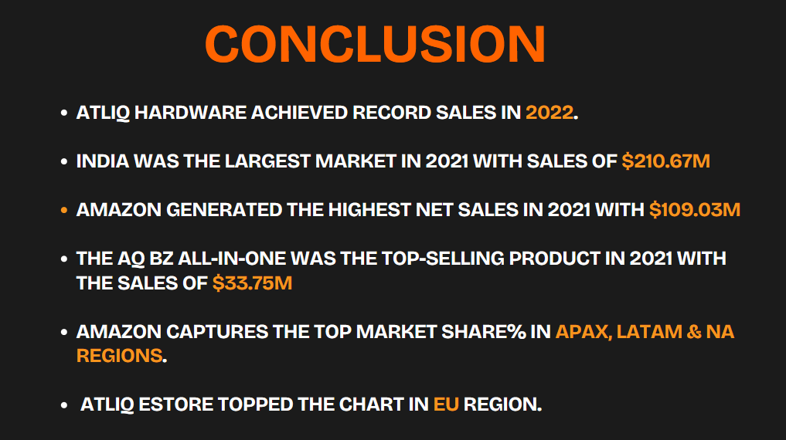

Slide 32
THANK YOU

